Slide 1
REN302: AUTOMATION CONTROL SYSTEM
Lecture 4
MODELLING CONTROL SYSTEM
Eng. NIYITEGEKA Janvier
RP/IPRC TUMBA/ RE DEPARTMENT

Slide 2
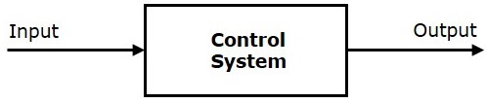
Introduction
The term process indicates a set up or a plant that we want to control.
A control system is a system, which provides the desired response by controlling the output.

Slide 3


Cont’d
The main feature of control system is that there should be a clear mathematical relation between input and output of the system.
When the relation is represented by a linear function, the system is called linear control system, otherwise a non-linear control system.

Slide 4
Characteristics of a Process
In general a process may have several input variables and several output variables.
But only one or two (at most few) of the input variables are used to control the process.
These inputs, used for manipulating the process are called manipulating variables.
The other inputs those are left uncontrolled are called disturbances.
Few outputs are measured and fed back for comparison with the desired set values.

Slide 5
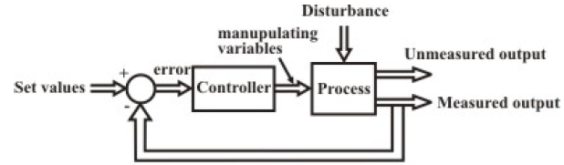
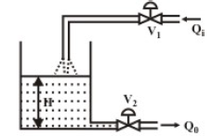
Disturbance illustration

Slide 6
Laplace Transform

Slide 7

Laplace Transform
It is a mathematical tool used to solve linear differential equation developed while modeling physical systems, mostly electrical and mechanical in relation with control system Formula:
https://www.iit.edu/sites/default/files/2021-02/laplacetransformiit.pdf

Slide 8
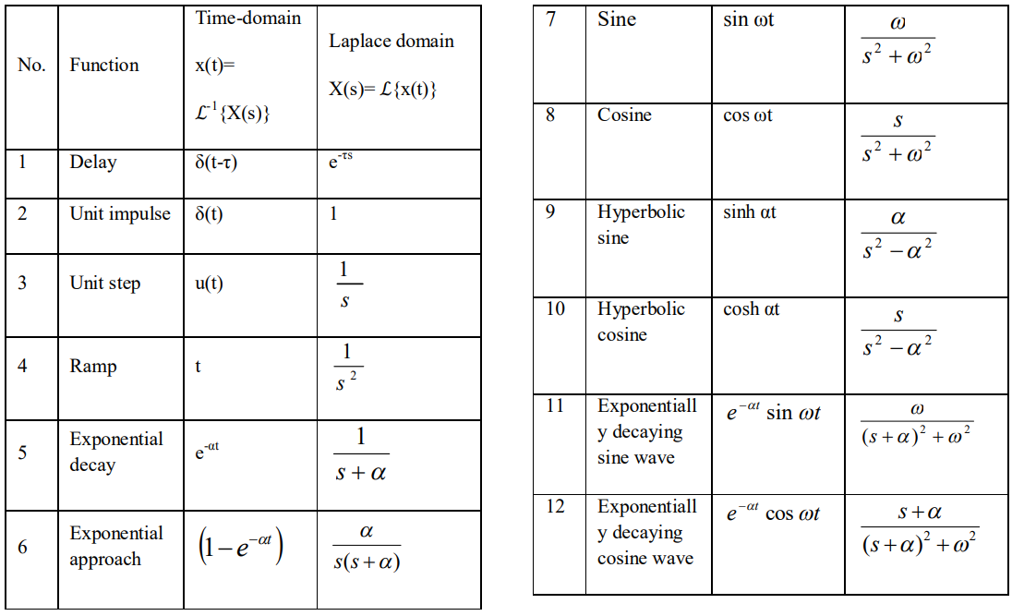
Laplace transform summary

Slide 9
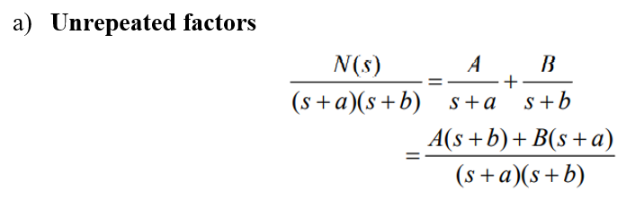
Solution of system dynamics in Laplace form
Unrepeated factors
Unrepeated complex factors
By equating both sides, determine A and B.

Slide 10
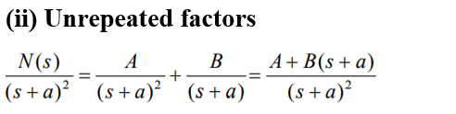
Cont’d
By equating both sides, determine A and B.

Slide 11

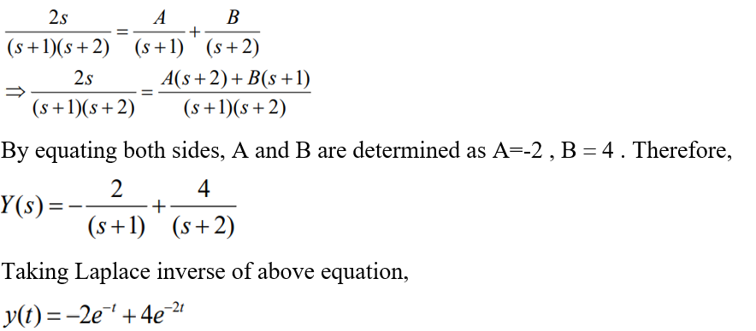
Cont’d
Example: Expand the following equation of Laplace transform in terms of its partial fractions and obtain its time-domain response.
Solution:

Slide 12
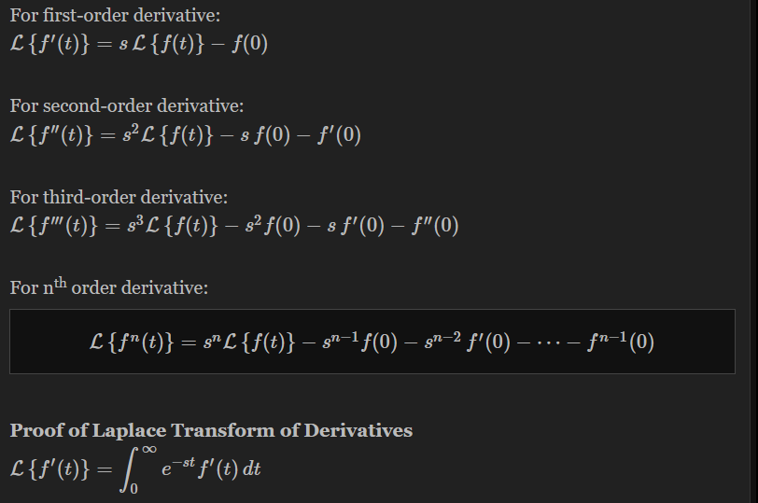
Laplace Transform of Derivatives

Slide 13
Mathematical Models of Control Systems

Slide 14
Cont’d
The control systems can be represented with a set of mathematical equations known as mathematical model.
Analysis of control system means finding the output when we know the input and mathematical model.
Design of control system means finding the mathematical model when we know the input and the output

Slide 15
Types of models used
The following mathematical models are mostly used.
1) Differential equation
2) Transfer function

Slide 16
Differential Equation Model
Differential equation model is a time domain mathematical model of control systems.
Follow these steps for differential equation model.
Apply basic laws to the given control system.
Get the differential equation in terms of input and output.

Slide 17
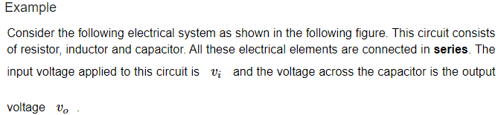
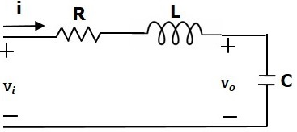

Slide 18
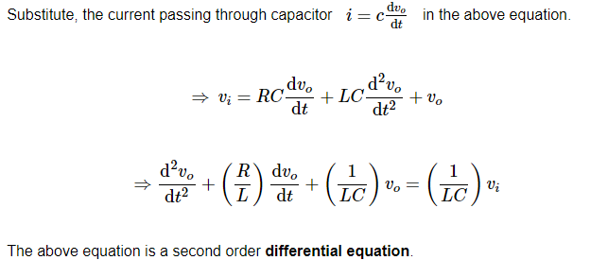

Slide 19
TRANSFER FUNCTION Model

Slide 20
Cont’d
Transfer function is defined as the ratio of the Laplace transform of the output variable to the Laplace transform of the input variable, with all zero initial conditions.
If x(t) and y(t) are the input and output of a LTI system, then the corresponding Laplace transforms are X(s) and Y(s).
Therefore, the transfer function of a LTI system is equal to the ratio of Y(s) and X(s)

Slide 21

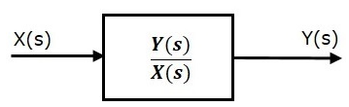

Slide 22


Linear Time-Variant vs Linear Time-Invariant Systems
A time-variable differential equation is a differential equation with one or more of its coefficients are functions of time.
A time-invariant differential equation is a differential equation in which none of its coefficients are independent of time variable, t

Slide 23
Cont’d
Where G(s) = M(s)/N(s) is the transfer function of the system; the roots of N(s) are called poles of the system and the roots of M(s) are called zeros of the system.
By setting the denominator function to zero, we obtain what is referred to as the characteristic equation

Slide 24
Cont’d
To derive the transfer function of a system, we use the following procedures:
Develop the differential equation for the system by using the physical laws, e.g. Newton’s laws and Kirchhoff’s laws.
Take the Laplace transform of the differential equation under the zero initial conditions.
Take the ratio of the output Y(s) to the input U(s).

Slide 25
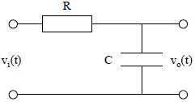
Example: Consider the following RC circuit. Find the transfer function of the network,

Slide 26
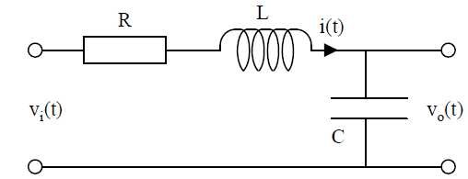
Exercise: Consider the LCR electrical network shown in the figure below. Find the transfer function G(s) = Vo(s)/Vi(s).

Slide 27
Control Systems - Block Diagrams

Slide 28
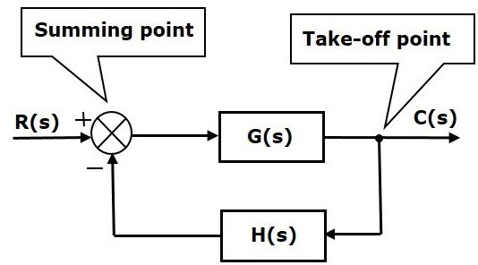
Basic Elements of Block Diagram

Slide 29
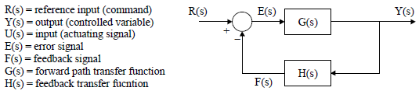
Block diagram terminology

Slide 30
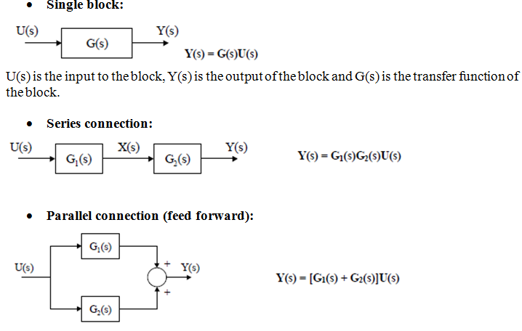
Block diagram reduction

Slide 31
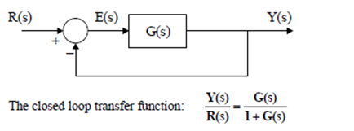
Negative feedback system (closed-loop system):

Slide 32
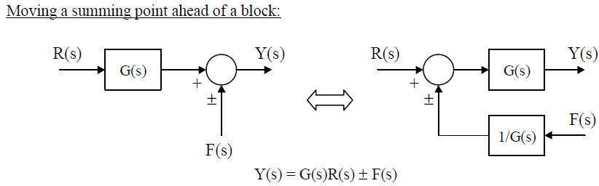
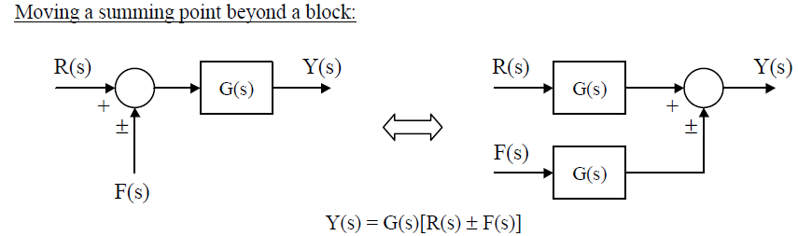
Block diagram reduction

Slide 33
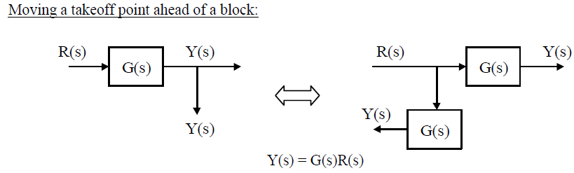
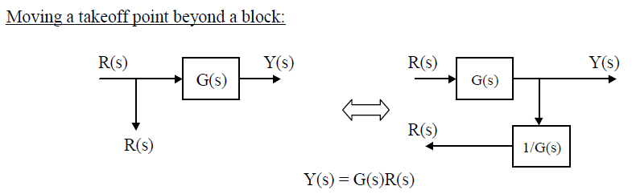

Slide 34
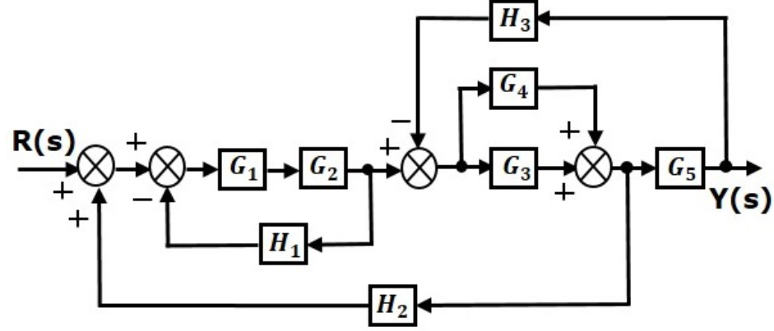
Example: Consider the block diagram shown in the following figure. Reduce this block diagram using the block diagram reduction rules.

Slide 35
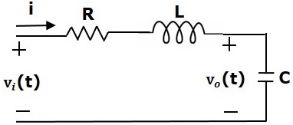
Block Diagram Representation of Electrical Systems
Electrical systems contain mainly three basic elements — resistor, inductor and capacitor.
Consider a series of RLC circuit as shown in the following figure
Where, V_{i}(t) and V_{o}(t) are the input and output voltages.
Let i(t) be the current passing through the circuit. This circuit is in time domain.

Slide 36
Steps of drawing a block diagram of any electrical circuit or system
Convert the time domain electrical circuit into an s-domain electrical circuit by applying Laplace transform.
Write down the equations for the current passing through all series branch elements and voltage across all shunt branches.
Draw the block diagrams for all the above equations individually.
Combine all these block diagrams properly in order to get the overall block diagram of the electrical circuit (s-domain).

Slide 37
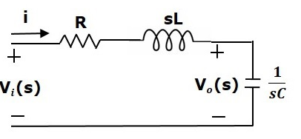
By applying the Laplace transform to this circuit, will get the circuit in s-domain.
The circuit is as shown in the following figure.

Slide 38
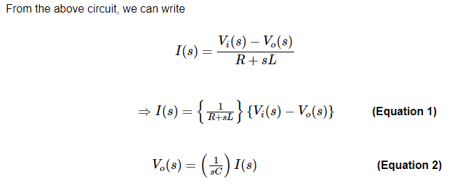

Slide 39
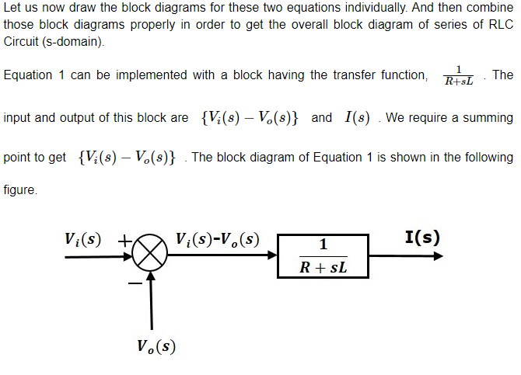

Slide 40
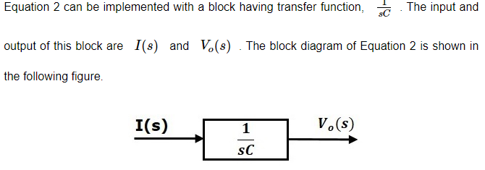

Slide 41
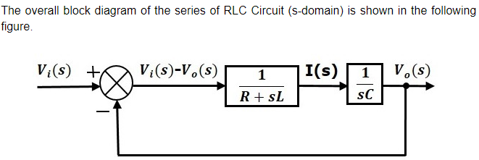

Slide 42
Reference
https://www.eeweb.com/electric-network-transfer-function/
https://www.tutorialspoint.com/control_systems/control_systems_block_diagram_reduction.htm

Slide 43
PID CONTROL TECHNIQUE

Slide 44
PID stands for Proportional-Integral-Derivative.
These three controllers are combined in such a way that it produces a control signal.

Slide 45
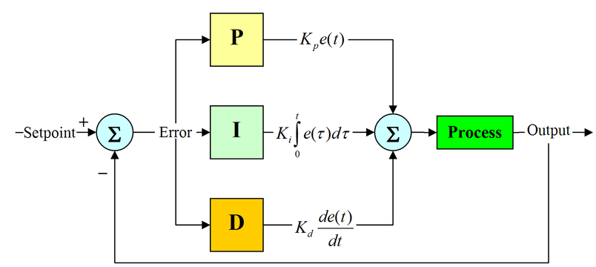
PID Control

Slide 46
PID implementation
Before microprocessors were invented, PID control was implemented by the analog electronic components.
Today all PID controllers are processed by the microprocessors.
Programmable logic controllers also have the inbuilt PID controller instructions.

Slide 47
Working of PID Controller
PID controller maintains the output such that there is zero error between process variable and set point/ desired output by closed loop operations.

Slide 48
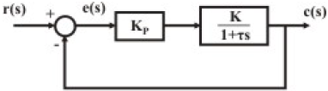
P- Controller:
Let consider the plant as a simple first order system

Slide 49
P- Controller:
Proportional or P- controller gives output which is proportional to current error e (t).
It compares desired or set point with actual value.
The resulting error is multiplied with proportional constant to get the output.
It provides stable operation
Maintains the steady state error.
Speed of the response is increased when the proportional constant Kc increases.

Slide 50
Steady state error
This is the state offset between the desired response and the output response.
This offset can be reduced by increasing the proportional gain; but that may also cause increase oscillations for higher order systems.

Slide 51
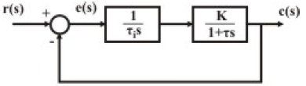
Integral Control

Slide 52
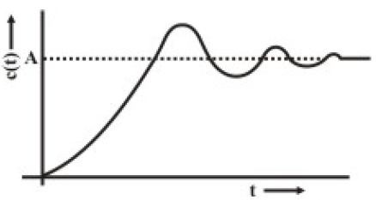
Step response
The steady state error due to step input reduces to zero.
But simultaneously, the system response is generally slow, oscillatory and unless properly designed, sometimes even unstable.

Slide 53
Cont’d
I-controller is needed, which provides necessary action to eliminate the steady state error.
It integrates the error over a period of time until error value reaches to zero.
Speed of the response is increased by decreasing integral gain Ki.

Slide 54
D-Controller
I-controller doesn’t have the capability to predict the future behavior of error.
D-controller overcomes this problem by anticipating future behavior of the error.
Increasing the derivative gain increases speed of response.

Slide 55
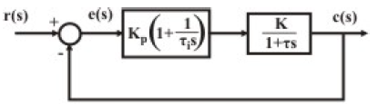
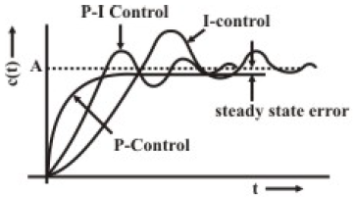
(P-I) Control
It is evident from the above discussions that the P-I action provides the dual advantages of:
fast response due to P-action
Zero steady state error due to I-action.

Slide 56
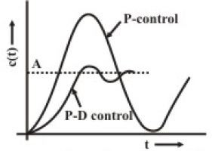
(P-D) Control
Apparently is not very useful, since it cannot reduce the steady state error to zero.
The stability of the closed loop system can be improved using P-D controller.

Slide 57

Proportional-Integral-Derivative (PID) control
The transfer function of a P-I-D controller is given by:
PID controllers have also been found to be robust, it finds wide acceptability for industrial processes.
The proper use, a controller has to be tuned for a particular process; i.e. selection of P,I,D parameters are very important.
Unless the parameters are properly chosen, a controller may cause instability to the closed loop system.

Slide 58
Controller Tuning
The process of experimentation for obtaining the optimum values of the controller parameters with respect to a particular process is known as controller tuning.

Slide 59

Cont’d
Our objective is to find out the optimum settings of the P,I,D parameters, namely Kp, τd and τi through experimentation,

Slide 60
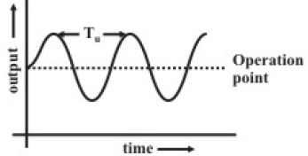
Closed Loop Technique (Continuous Cycling method)
Here, the controller is first set to P-mode, making τ_{d}=0 and τ_{i}=∞.
The proportional gain K_{p} is increased gradually to K_{p} = K_{p max} till the system just starts oscillating with constant amplitude continuously.

Slide 61
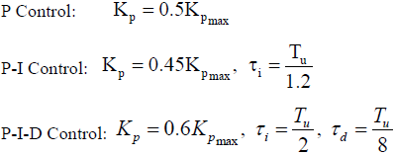
Cont’d
The time period of continuous oscillation T_{u} is noted.
The recommended optimum settings are:

Slide 62

Questions and Discussions
Thank you

